Slide 1
King County Inventory Training
Providers

Slide 2

Agenda
What is INVENTORY
Status vs. Availability
Workflows
Maintaining Units
Reports

Slide 3
What is INVENTORY?

Slide 4
What is INVENTORY?
Program-Level
INVENTORY
Store counts of bed and units per program
Refer to a program
HUD compliant
Real-time/dynamic tracking of units/openings
Refer to a unit/opening
HUD compliant
Tracking units
and openings
Referrals
HUD
Compliance

Slide 5


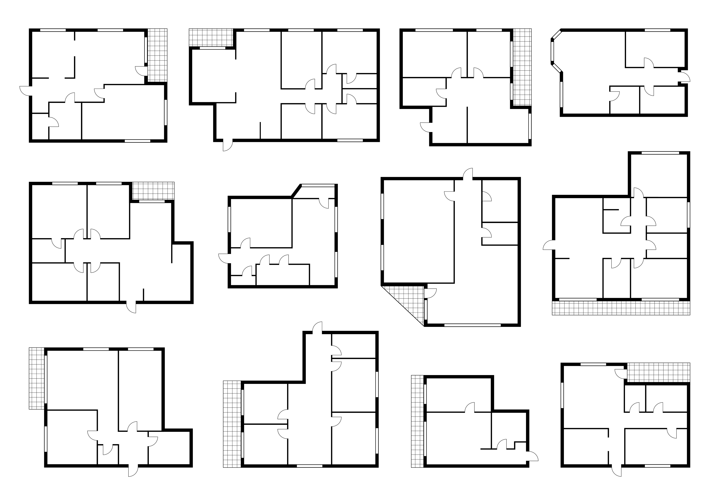





Clarity INVENTORY
Sites
Buildings
Unit Configurations
Units

Slide 6
Status &
Availability

Slide 7
Status and Availability
Status
Availability
Indicates a unit’s usage
Active
Inactive
Offline
Provides Occupancy Information
Available
Occupied
Pending Occupancy
Inactive
Offline
Units with these statuses can’t be occupied

Slide 8


Status and Availability
Status
Availability
Changed manually
Can be automatic at move-out
Changes based on activity in the system
(Referrals, unit connection, exits)

Slide 9
INVENTORY
Dashboard

Slide 10
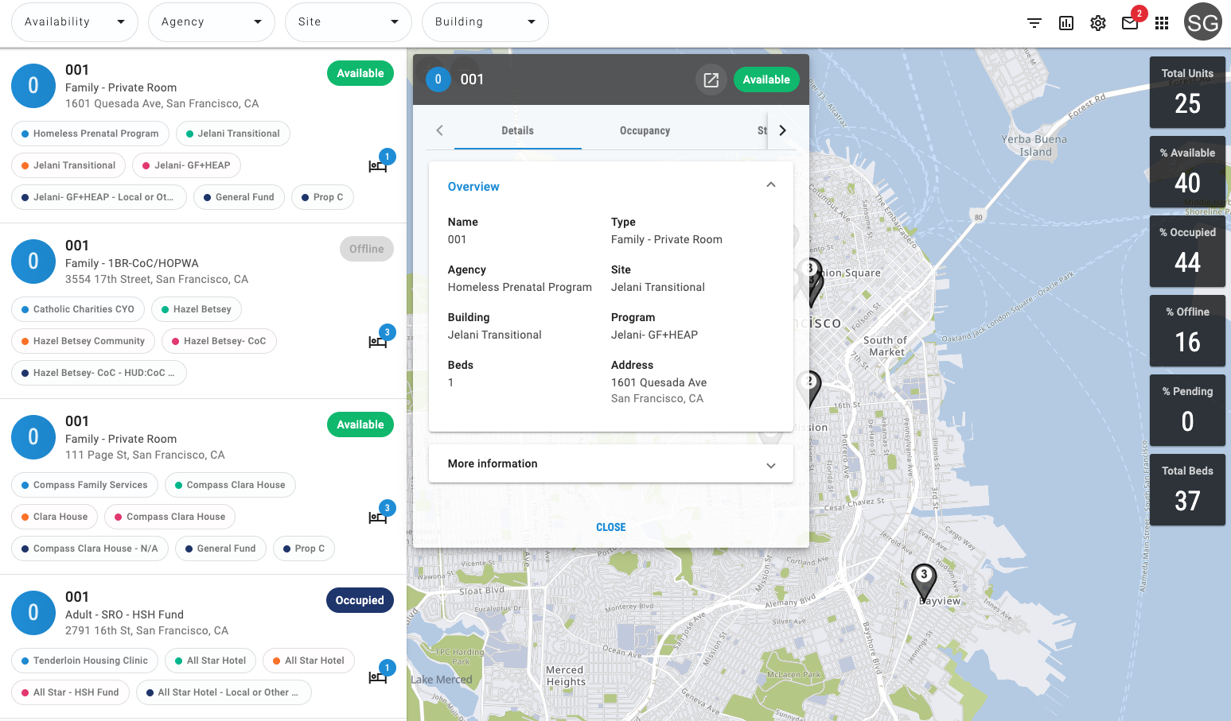
INVENTORY Dashboard
Filter dashboard to locate available units
Utilize custom filters to refine search
Display cards show additional details about a unit
Confidential and Proprietary | © Copyright 2024 Bitfocus, Inc., All Rights Reserved.
Notes:
Update slide

Slide 11
Workflow

Slide 12
Workflows
Coordinated Entry Workflow
Unit Turnover
Non-Coordinated Entry Workflow
Unit Turnover
Referral
Accepting/Denying Referral
Exit
Enrollment
Exit
Enrollment
Confidential and Proprietary | © Copyright 2024 Bitfocus, Inc., All Rights Reserved.
Notes:
Update slide

Slide 13
Current Non-Coordinated Entry Workflow
Program Enrollment
Exit Client when no Longer Receiving Services
Unit Turnover/ Available Unit

Slide 14
New Non-Coordinated Entry Workflow
*New*
Program Enrollment
Exit Client when no Longer Receiving Services
End Offline Status
Unit Assignment
*New*

Slide 15
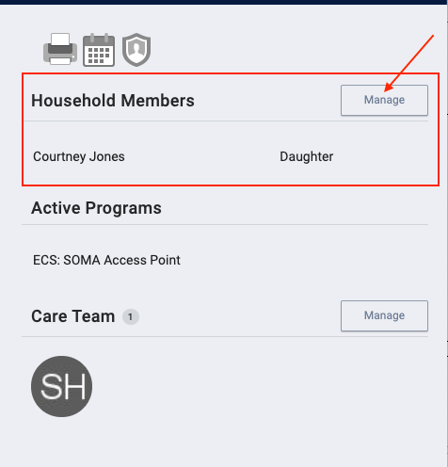
Household Composition
Confirm the household composition is correct
Add or remove people if needed

Slide 16
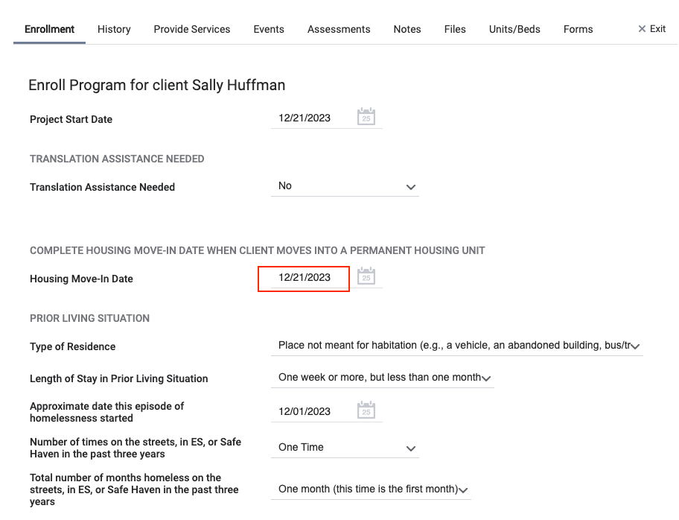
Enrollment
Complete as many fields as possible
Update auto-populated fields, if necessary
For households, complete the enrollment screen for each person
Confidential and Proprietary | © Copyright 2024 Bitfocus, Inc., All Rights Reserved.

Slide 17
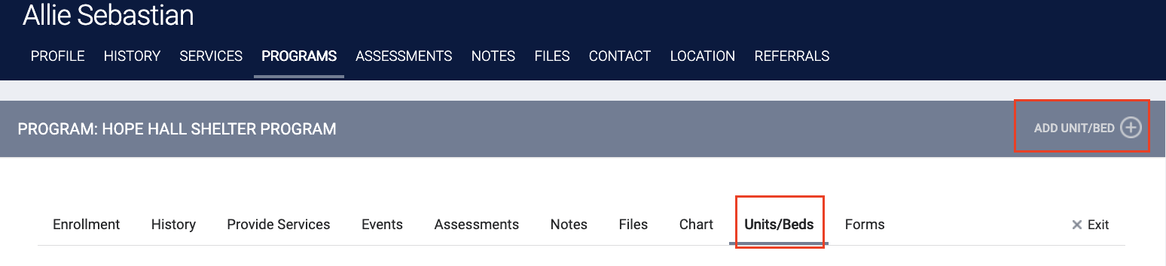
Unit Assignment
Completed under the Unit/Bed Tab
Completed at the time of enrollment
Only the HoH is assigned to the unit

Slide 18
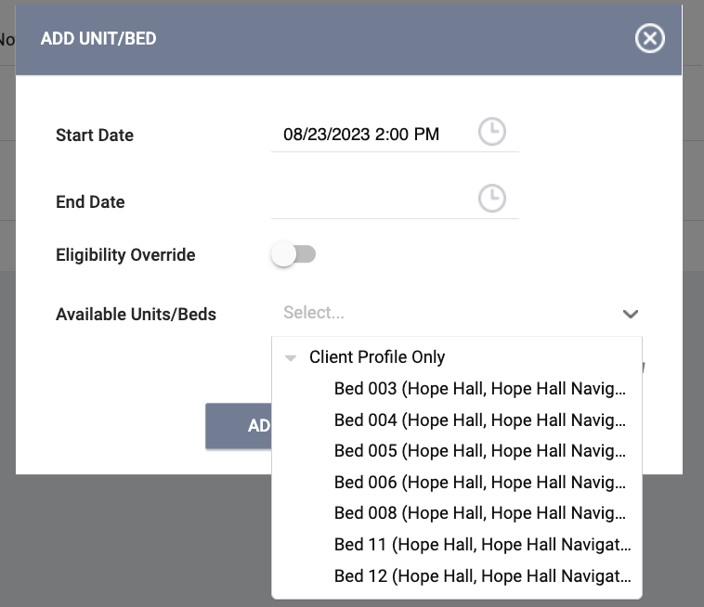
Unit Assignment
Add Start Date
Leave End Date blank
Click Available Units
  Click Client Profile and select the unit the client was referred to

Slide 19
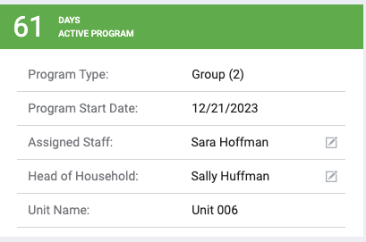
Enrollment Sidebar
Current Unit assignment is visible in the enrollment sidebar
Confidential and Proprietary | © Copyright 2024 Bitfocus, Inc., All Rights Reserved.

Slide 20

Changes to Coordinated Entry Workflow
Post program opening
Referral
Accept Referral/ Program Enrollment
Manually Repost Opening when Client Moves
Pending In-Process
End the offline status when turnover is done
Status changes to offline or available at move out

Slide 21
New Coordinated Entry Workflow
End Offline
Status
Referral to
Available Unit
Program Enrollment + Unit Assignment
Program
Exit
Referral Status Changed to Pending In-Process

Slide 22
Referral
End Offline
Status
Referral to
Available Unit
Program Enrollment + Unit Assignment
Program
Exit
Referral Status Changed to Pending In-Process

Slide 23
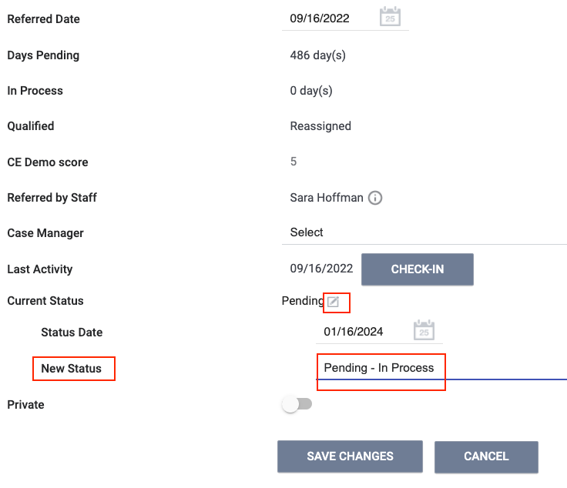
Pending In-Process
Change the status under the Pending Tab
Change within within 48 hours of receiving referral
Notifies the access points the referral was received
Confidential and Proprietary | © Copyright 2024 Bitfocus, Inc., All Rights Reserved.
Notes:
Update slide

Slide 24
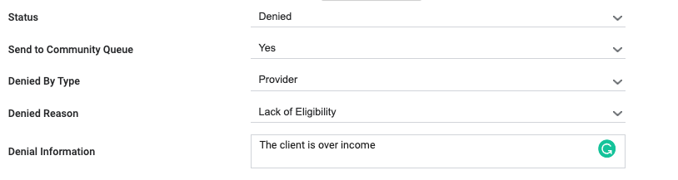
Denied Referrals
If a client refuses housing or is deemed ineligible, staff will:
  Send client back to the Community Queue
  Select denial type
  Provide additional details
Confidential and Proprietary | © Copyright 2024 Bitfocus, Inc., All Rights Reserved.

Slide 25
Enrollment + Unit Assignment
End Offline
Status
Referral to
Available Unit
Program Enrollment + Unit Assignment
Program
Exit
Referral Status Changed to Pending In-Process

Slide 26
Household Composition
Confirm the household composition is correct
Add or remove people if needed

Slide 27
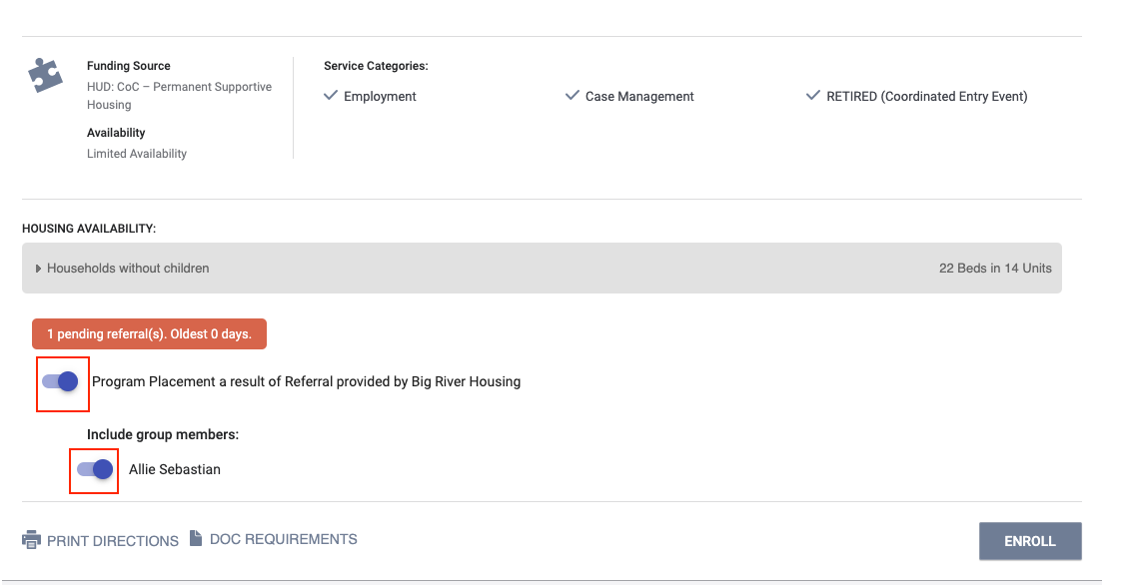
Accepting Referrals
Enrolling into the program, will complete the referral
  The "Program Placement a result of..." toggle must be on
  The orange box lets you know you’re enrolling into the correct program
Confidential and Proprietary | © Copyright 2024 Bitfocus, Inc., All Rights Reserved.

Slide 28
Enrollment
Complete as many fields as possible
Update auto-populated fields, if necessary
If enrolling a household, complete the enrollment screen all household members
Confidential and Proprietary | © Copyright 2024 Bitfocus, Inc., All Rights Reserved.

Slide 29
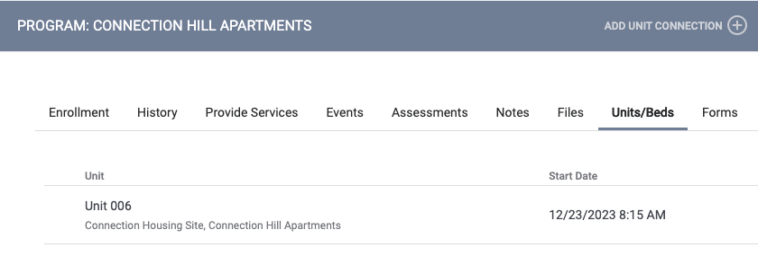
Unit Assignment
Unit assignment happens automatically when the referral is completed
“Unit Start Date” should match the “Housing Move-In Date”
  “Unit Start Date” defaults to current date, may need to updated match Housing Move-in Date

Slide 30
Enrollment Sidebar
Current Unit assignment is visible in the enrollment sidebar
Confidential and Proprietary | © Copyright 2024 Bitfocus, Inc., All Rights Reserved.

Slide 31
Transfers
End Offline
Status
Referral to
Available Unit
Program Enrollment + Unit Assignment
Program
Exit
Referral Status Changed to Pending In-Process
Transfers

Slide 32
Transfers
Same agency and program
Same agency, different program
Mobility transfer (different agency)

Slide 33
Same Agency, Same Program
Client is moving into a different unit with the same program
End stay in current unit
Assign to new unit
End Date
Start Date
Confidential and Proprietary | © Copyright 2024 Bitfocus, Inc., All Rights Reserved.

Slide 34
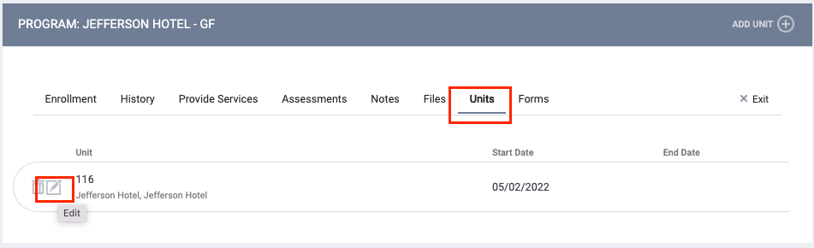
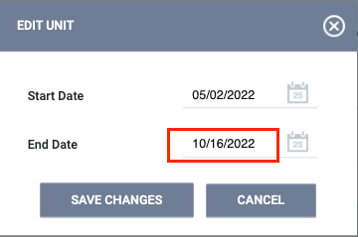
Same Agency, Same Program
End date of the current unit should be the last day the client slept in the unit
Confidential and Proprietary | © Copyright 2024 Bitfocus, Inc., All Rights Reserved.

Slide 35

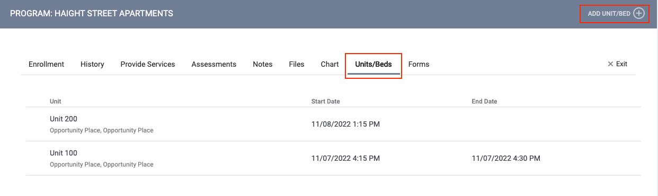
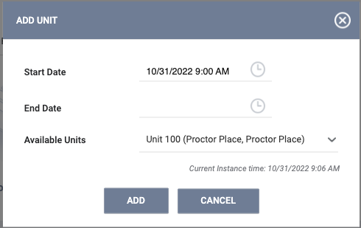
Same Agency, Same Program
Start date for the new unit is the first day the client will sleep in the unit
Note: Start date should not overlap with the end date of last unit
Confidential and Proprietary | © Copyright 2024 Bitfocus, Inc., All Rights Reserved.

Slide 36
Same Agency, Different Program
Client is moving to a unit in a different program
Exit client from the program
Enroll in new program
Automatically ends unit stay
Assign client to unit
Confidential and Proprietary | © Copyright 2024 Bitfocus, Inc., All Rights Reserved.

Slide 37
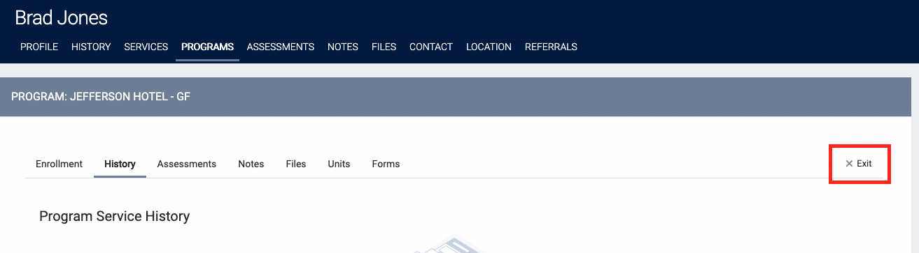
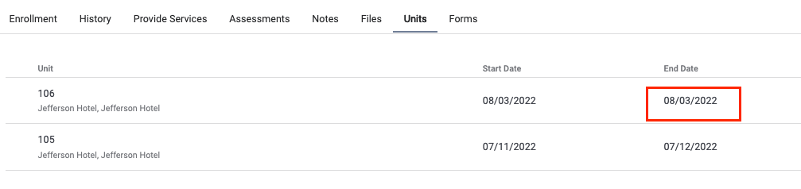
Same Agency, Different Program
Exit the client from the program
  Automatically ends unit stay
Confidential and Proprietary | © Copyright 2024 Bitfocus, Inc., All Rights Reserved.

Slide 38
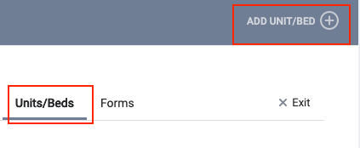
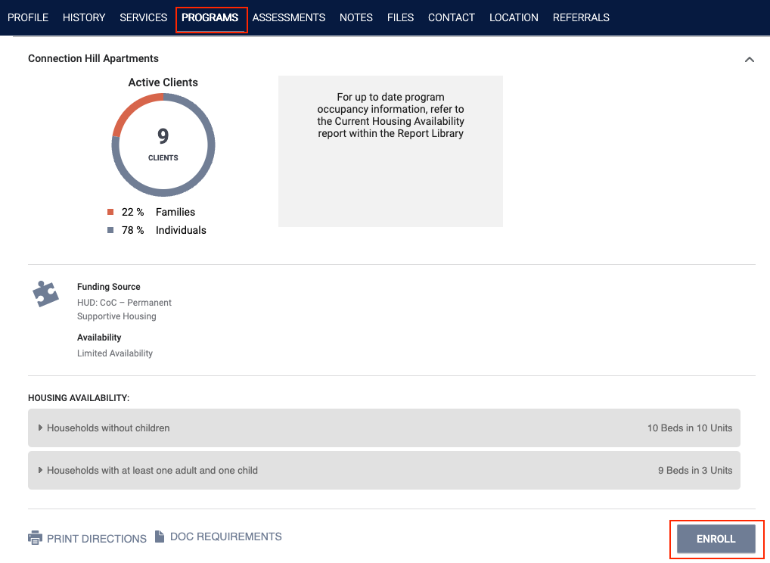
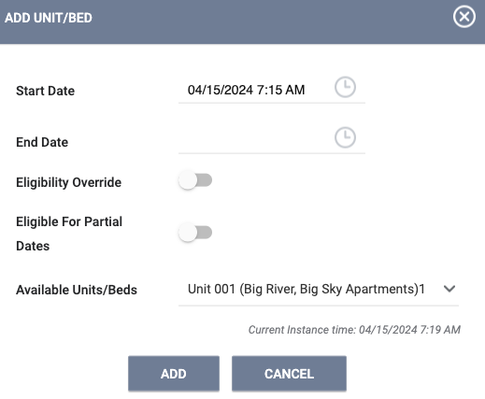
Same Agency, Different Program
Enroll the client into the new program
Assign the client to a unit
Confidential and Proprietary | © Copyright 2024 Bitfocus, Inc., All Rights Reserved.

Slide 39
Exits
End Offline
Status
Referral to
Available Unit
Program Enrollment + Unit Assignment
Program
Exit
Referral Status Changed to Pending In-Process
Auto-Offline Status

Slide 40
Exiting Client from Unit
Exits should occur when a client is no longer receiving services
Exiting a client from a program will also end their unit stay
  Complete an exit for all household members
Confidential and Proprietary | © Copyright 2024 Bitfocus, Inc., All Rights Reserved.

Slide 41
Maintaining Units

Slide 42
Automatic Offline Status
Unit changes to offline when client exits
Allows time for unit turnover
Stays offline for 1 week
Continuum Project= Yes

Slide 43
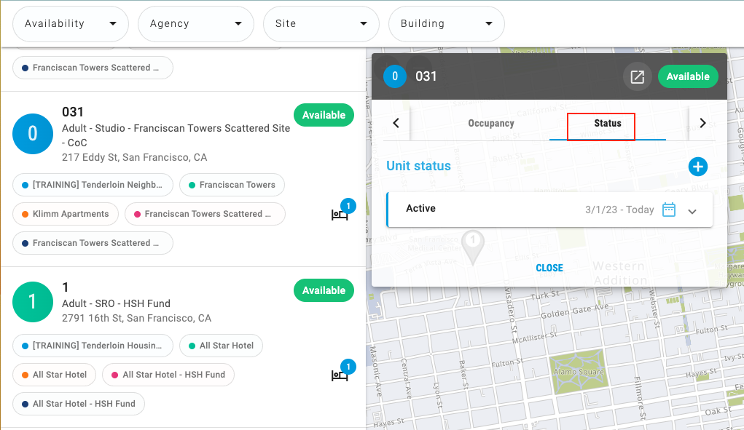
Making Units Offline
Add Offline Status under the Status Tab
Leave the End Date blank
Unit Statuses cannot overlap
Confidential and Proprietary | © Copyright 2024 Bitfocus, Inc., All Rights Reserved.

Slide 44
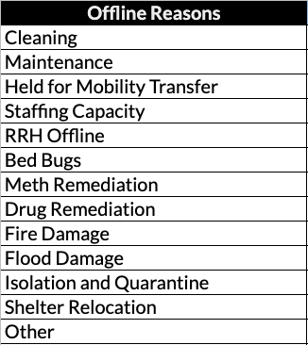
Offline Reasons
Offline reasons identify why a unit is not available
Use these categories to keep units up-to-date with the most current circumstance
Provide additional details under Offline Description
Confidential and Proprietary | © Copyright 2024 Bitfocus, Inc., All Rights Reserved.

Slide 45
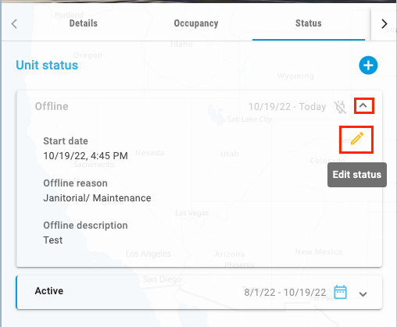
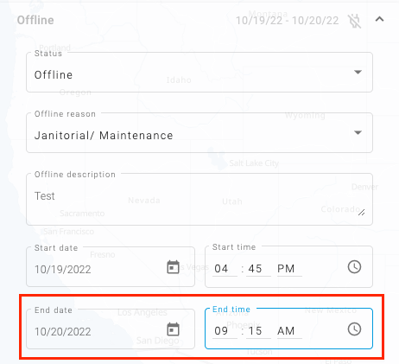
Ending Offline Status
Click the pencil icon to edit the status
Add an end date to make a unit active/available
Confidential and Proprietary | © Copyright 2024 Bitfocus, Inc., All Rights Reserved.

Slide 46
Changing Unit Configuration Types
Update the unit configuration if information about the unit changes
Change from the Inventory Dashboard
  Examples: Household type, bed count, shared vs. private room
  Currently applied to the unit
  Scheduled to change on specific date
  Possible UCTs for the unit
  All UCTs created for the site
Current
Upcoming
Available
Unavailable

Slide 47
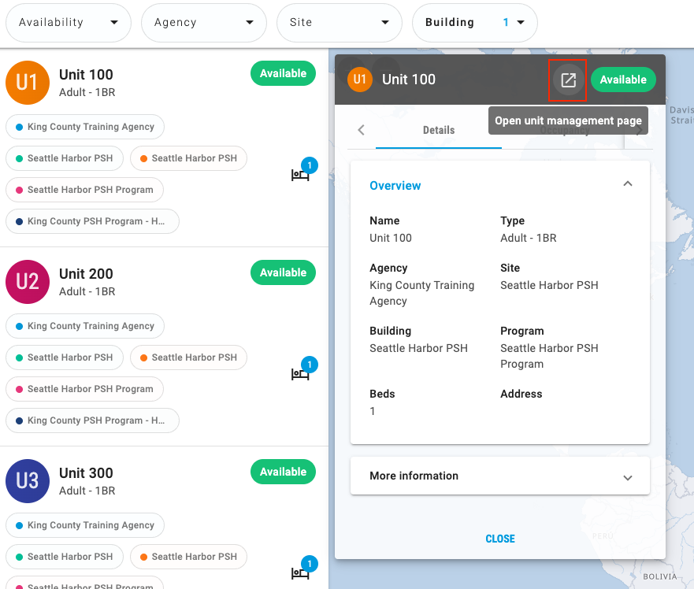
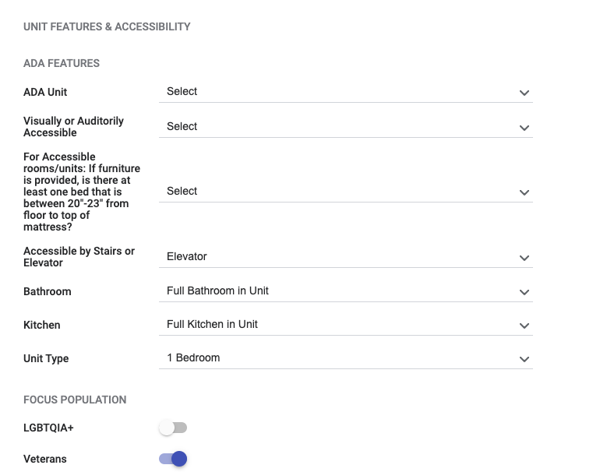
Updating Unit Attributes
Update unit attributes if things change over time.
Check and update Referral Pathway-Housing field
Update fields

Slide 48
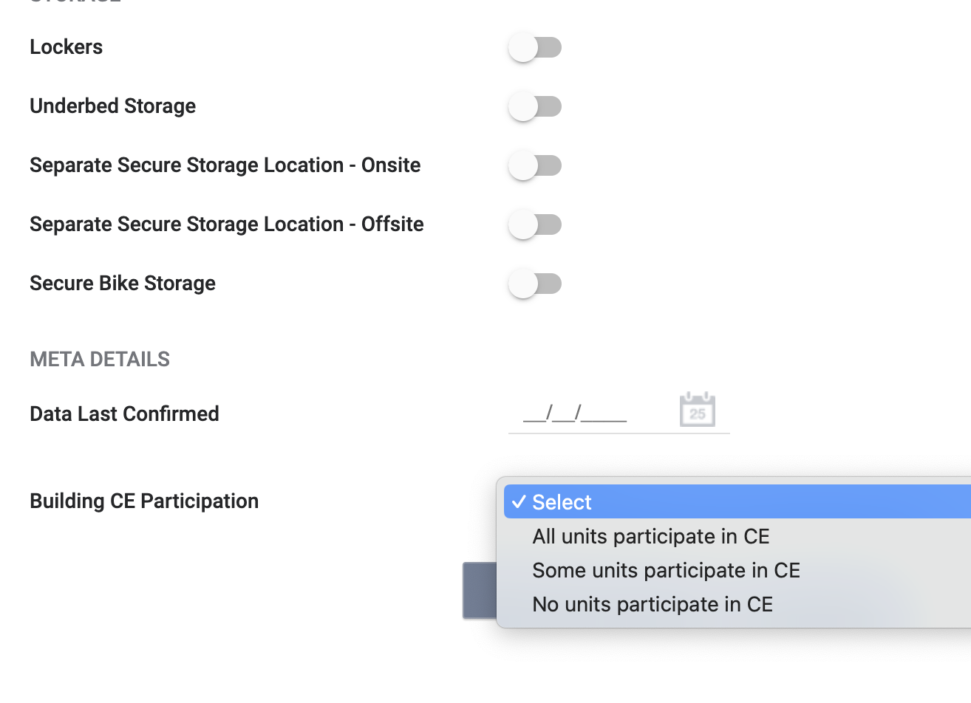
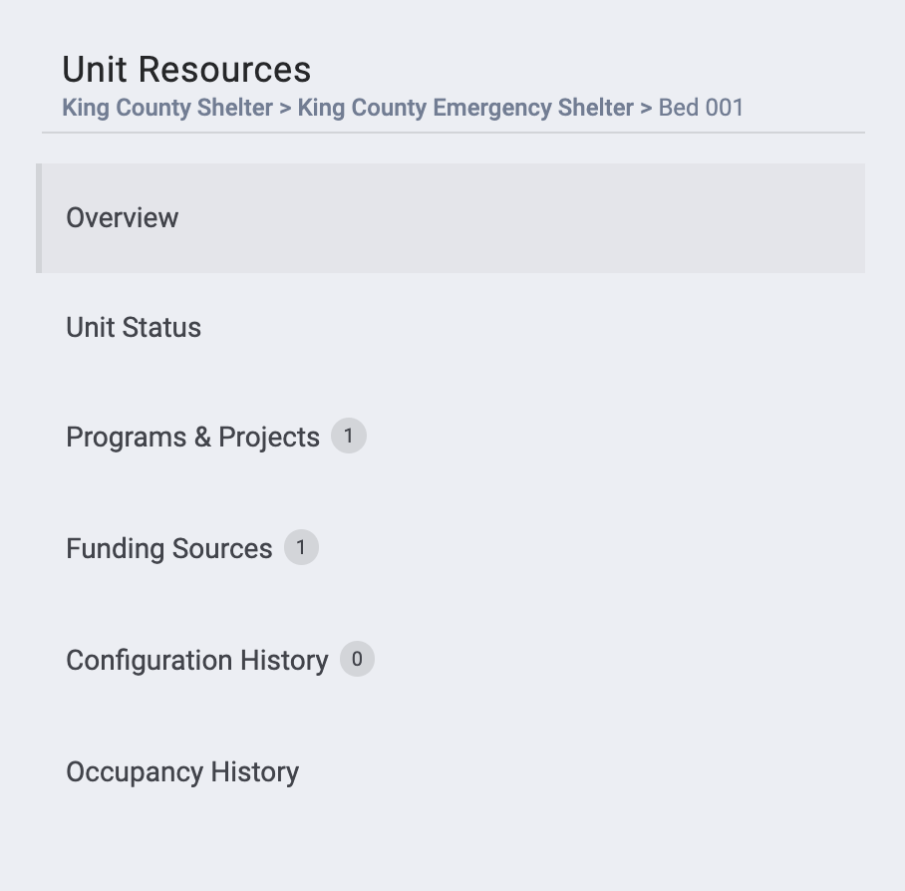
Updating Building Attributes
Update building attributes if things change over time.
Check and update Building CE Participation field
Update fields

Slide 49
Reports

Slide 50
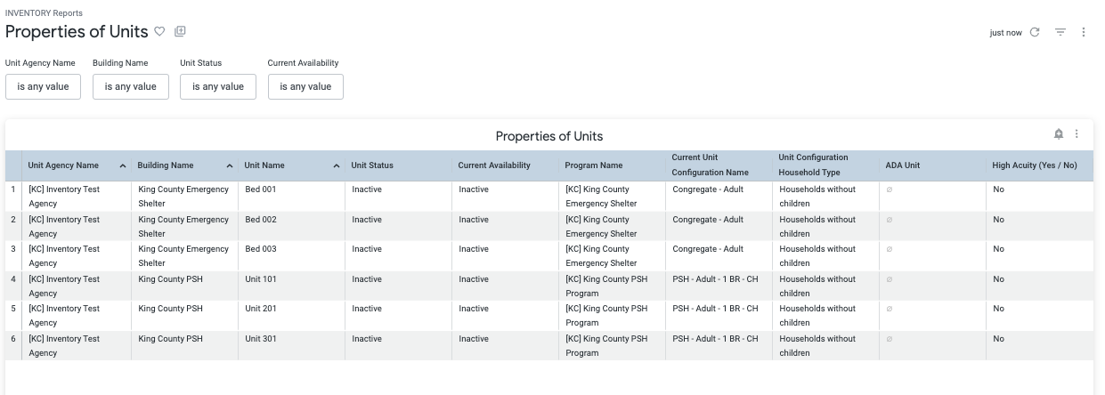
Properties of Units Report
Provides information on the setup of each unit
Contact your agency lead if you don’t have access to view the report or make updates
Notes:
Add screenshot

Slide 51
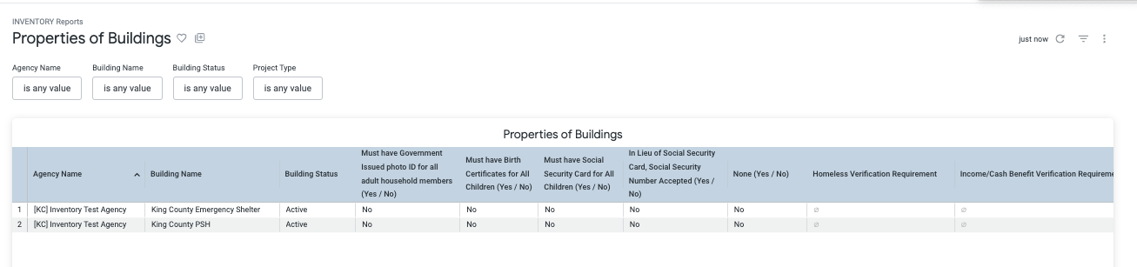
Properties of Buildings Report
Provides information on the setup of each building
Contact your agency lead if you don’t have access to view the report or make updates
Notes:
Add screenshot

Slide 52

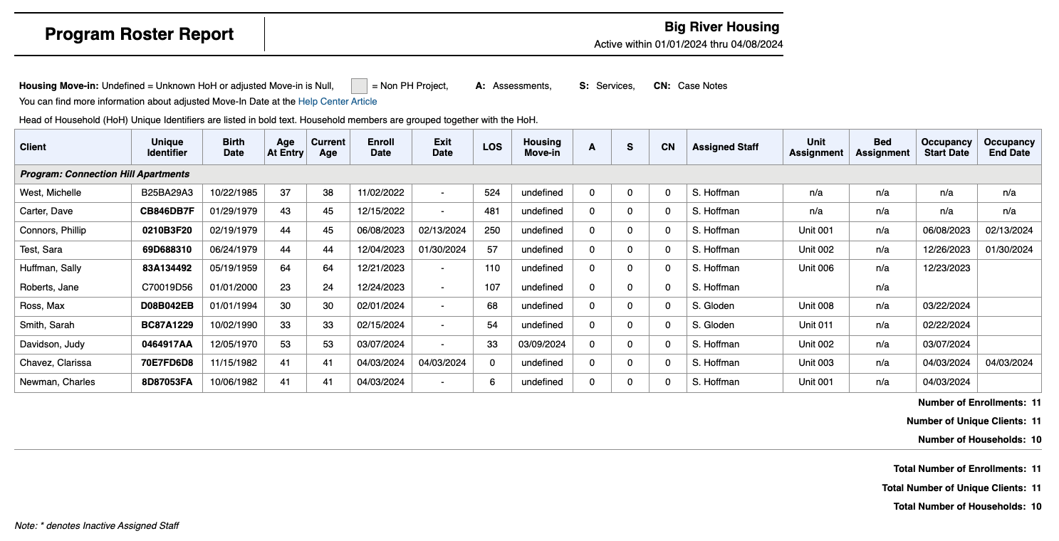
Program Roster
Provides information on households assigned to a unit/opening

Slide 53
Program Roster
Check for enrolled clients without a unit assignment (n/a) and assign unit to the enrollment
Exit clients who are no longer in the program

Slide 54


Next Steps
Staff will have new access in Clarity June 18
Unit assignments and building/unit field review completed by:
  CE units- July 12
  Non-CE units (including shelter and TH)- August 24
Blackout period (no referrals)– July 11-16
New workflow begins on July 17

Slide 55
Resources
Training materials can be found at
https://kingcounty.bitfocus.com/kc-training-manuals-and-guides
Email questions to kcsupport@bitfocus.com
Office Hours https://kingcounty.bitfocus.com/
  Friday, June 21 at 10:00 a.m. Register Here
  Ongoing weekly on Wednesday (starting June 26) at 2:00 p.m. Register Here
Confidential and Proprietary | © Copyright 2024 Bitfocus, Inc., All Rights Reserved.

Slide 56

Questions?

